Slide 1
CIS387/ECE387
Digital Forensics I
Linux Data Acquisition
Notes:
Guide to Computer Forensics and Investigations Fifth Edition
Chapter 3
Data Acquisition

Slide 2
Four Basic Forensics Steps
Collect
Preserve
Analyze
Present (report)

Slide 3
Preparation
A tool box (CD or USB) containing trusted forensics tools.
A powerful machine with forensic tools installed and clean-wiped hard drive to store acquired evidence

Slide 4
Notes
Always have your OWN tool sets ready!
  You are dealing with a compromised system
Run tools from your OWN USB or device
Save the output outside the compromised system.

Slide 5
Forensics tool in common
Ensure forensically-sound operations
Process data structure from the image bypassing kernel’s support
Work on both images and live systems
Notes:
Often need to work on live systems to get RAM and also it can be hard to remove hard drive disk space from many devices without risking damage (such as mobile devices).

Slide 6
Basic Acquisition Steps
Obtain volatile data (including RAM) – According to policy and the case nature
Acquire non-volatile data (image drives and removable media)

Slide 7
Acquire volatile information
System information
Memory usage
Running processes
Logged in users
Network connections
Network interface configuration (promiscuous mode?)
…….
Notes:
System information (which can potentially be inaccurate): get → date, uptime (you can use uptime to see if/when system was rebooted last since many times people reboot to hide and wide data, etc.).
“ip link show” cmd on Linux will show layer 2 information (“ip address show” shows layer 2 and layer 3 information).
Promiscuous mode: network card accept all messages → even messages not designated/addressed to that particular network card; network card does not ignore any destination address (reads all LAN messages that reach its interface).
Using this, many hackers can compromise one machine and compromise many more machines on a LAN from that one machine.
You can find out how many hosts in the network, etc.
So if system has a network card configured in promiscuous mode → likely someone was using the machine to monitor your network.

Slide 8
Volatile Evidence
Most volatile -> Least volatile -> Nonvolatile
  Memory
  Swap space or pagefile
  Network status and connection
  Processes running
  File opening
  Hard drive media
  Removable media (CD, USB, etc.)
Notes:
Get memory acquisition in the above order shown (pretty intuitive).

Slide 9
lsof (Linux Command)
List open files: a regular file, a directory, a block special file, a character special file, an executing text reference, a library, a stream or a network file
lsof [options] [filename/pid]
Command Lists…
lsof All open files belonging to all active processes
lsof –i [ipaddress] Internet connections belonging to the given ipaddress
lsof -i 4 -a -p 1234 All open IPv4 network files in use by the process whose PID is 1234
lsof /dev/hda3 All open files on device /dev/hda3,
lsof /u/abe/foo Finds the process that has /u/abe/foo open
Notes:
Lsof → lsof (the l is an L, not an i).
Remember when you open a file, the memory location of that file goes into the Open File Table (in RAM, as part of the kernel memory) in order to keep track of currently open files in memory.
File table has meta data information, such as the disk location from where the file was loaded.
You can also see the order in which the files were loaded into memory using the open file table.
Internet connections belonging to a given ip address == Layer 4 information (transport layer, such as TCP, or UDP, etc.) → show currently established connections on given ip addresses.
You can even use the lsof command as shown above to search open files that were opened from an external harddrive (whether locally connected or via a network drive).

Slide 10
lsof – find hidden disk spaces
Create a process that opens a file; unlink the file; continue to write to the file
  Disk resources remain in use
  File is invisible to the ls command
How to find them?
  Use lsof +L1 #show you all open files that have a link count less than 1
Notes:
Its possible to unlink a file and still write to it (use unlink command, to decrement the number of links by 1).
This can be typical behavior (temporary files), that loads a file into memory and mark as deleted (unlink) the file on the disk, so that when power is lost, data file is lost.
But hackers can exploit this and do it to hide files on the disk even though it is still loaded in RAM memory.
Idea is to be able to pull the power and not have to worry about the file being stored on or linked to a disk location upon reboot.
Once power is lost, file table is lost (and thus all linked files with count less than 1 will always be lost, in addition to all other linked files as well because entire open file table is in RAM, and thus processes would need to run and re-open files and link and unlink files via kernel processes in order to re-build the open file table).
So: make sure to check all open files including those files that are unlinked → link count < 1 = 0 (meaning (marked) deleted on disk, but still in RAM memory).
PERHAPS: we can copy the open file table! That way even if power is lost, we can still get meta data from the open file table we copied/saved and go to each disk location (including files with no linked files = link count < 1 = 0.)
Maybe this won’t work if files were was linked to virtual disk space and/or files rearranged on disk after reboot.

Slide 11
Use netcat (or cryptcat)
to transfer the retrieved data to a forensic workstation over the network
Setting up the netcat listener on the forensic workstation (e.g. 192.168.0.2)
  nc –l 2222 > Some_File_Name
Sending the info to the forensic workstation
  who | nc 192.168.0.2 2222
Notes:
2222 is the TCP port that the process is “listening” on (data on the shown ip address AND with the given port 2222 transport layer 4 TCP tag will be received by the process (nc is the name of this process/program).
Crpytcat is same as netcat command but it encrypts data before sending it over network.

Slide 12
Acquire RAM with physical access to the system
Memdump for Linux, Unix, FreeBSD, Solaris
  http://www.porcupine.org/forensics/tct.html
  Action is not guaranteed due to a restricted range of addresses
Linux Memory Extractor (LiME)
  A Loadable Kernel Module for acquiring Linux/Android physical memory
  https://github.com/504ensicslabs/lime
Fmem
  A kernel module fmem.ko that creates device /dev/fmem
  sudo dd if=/dev/fmem of=mem.dd (no restriction)
Notes:
Memdump: can be affected because kernel will restrict access to some address spaces because of data integrity and security between processes…etc. (CIS-450 Operating Systems concepts).
Can use Fmem kernel process to not restrict any access to any memory locations.

Slide 13
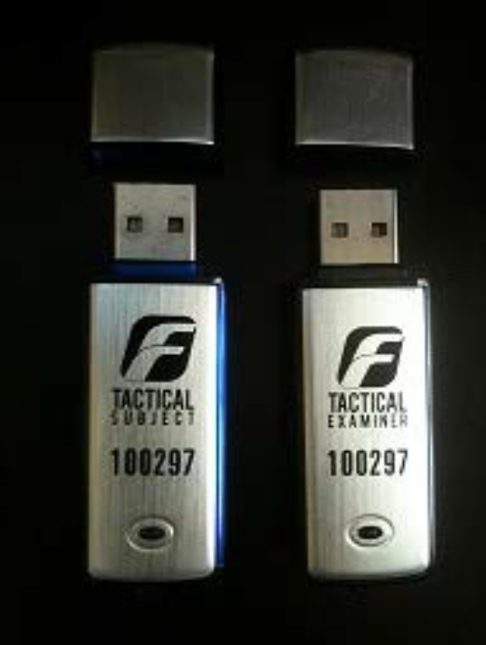
F-Response for remote acquisition
F-Response from https://www.f-response.com/
Use dual-dongle to conduct remote forensic acquisition of memory and disks.
  One dongle for subject system
  One dongle for examiner system
Notes:
The dongles connect to each other.

Slide 14
DISK IMAGING

Slide 15
Understanding Storage Formats for Digital Evidence
Data in a forensics acquisition tool is stored as an image file
Three formats
  Raw format
  Proprietary formats
  Advanced Forensics Format (AFF)
Notes:
Understanding Storage Formats for Digital Evidence
Data in a forensics acquisition tool is stored as an image file
Three formats
Raw format
Proprietary formats
Advanced Forensics Format (AFF)

Slide 16
Raw Format
Makes it possible to write bit-stream data to files
Advantages
  Fast data transfers
  Ignores minor data read errors on source drive
  Most computer forensics tools can read raw format
Disadvantages
  Requires as much storage as original disk or data
  Tools might not collect marginal (bad) sectors
Notes:
Raw Format
Makes it possible to write bit-stream data to files
Advantages
Fast data transfers
Ignores minor data read errors on source drive
Most computer forensics tools can read raw format
Disadvantages
Requires as much storage as original disk or data (because of no compression)
Tools might not collect marginal (bad) sectors

Slide 17
Proprietary Formats
Most forensics tools have their own formats
Features offered
  Option to compress or not compress image files
  Can split an image into smaller segmented files
  Can integrate metadata into the image file
Disadvantages
  Inability to share an image between different tools
  File size limitation for each segmented volume
The Expert Witness format is unofficial standard
Notes:
Proprietary Formats
Most forensics tools have their own formats
Features offered
Option to compress or not compress image files
Can split an image into smaller segmented files
Can integrate metadata into the image file
Disadvantages
Inability to share an image between different tools
File size limitation for each segmented volume
The Expert Witness format is unofficial standard
Often: law enforcement agencies use Encase tool.

Slide 18
Advanced Forensics Format
Developed by Dr. Simson L. Garfinkel as an open-source acquisition format
Design goals
  Provide compressed or uncompressed image files
  No size restriction for disk-to-image files
  Provide space in the image file or segmented files for metadata
  Simple design with extensibility
  Open source for multiple platforms and OSs
Notes:
Advanced Forensics Format
Developed by Dr. Simson L. Garfinkel as an open-source acquisition format
Design goals
Provide compressed or uncompressed image files
No size restriction for disk-to-image files
Provide space in the image file or segmented files for metadata
Simple design with extensibility
Open source for multiple platforms and OSs

Slide 19
Advanced Forensics Format
Design goals (cont’d)
  Internal consistency checks for self-authentication
File extensions include .afd for segmented image files and .afm for AFF metadata
AFF is open source
Notes:
Advanced Forensics Format
Design goals (cont’d)
Internal consistency checks for self-authentication
File extensions include .afd for segmented image files and .afm for AFF metadata
AFF is open source
Meta data for these program files include fields such as: examiner, time of data extraction, etc.

Slide 20
Determining the Best Acquisition Method
Types of acquisitions
  Static acquisitions and live acquisitions
Four methods of data collection
  Creating a disk-to-image file
  Creating a disk-to-disk
  Creating a logical disk-to-disk or disk-to-data file
  Creating a sparse data copy of a file or folder
Determining the best method depends on the circumstances of the investigation
Notes:
Determining the Best Acquisition Method
Types of acquisitions
Static acquisitions and live acquisitions
Four methods of data collection
Creating a disk-to-image file
Creating a disk-to-disk
Creating a logical disk-to-disk or disk-to-data file
Creating a sparse data copy of a file or folder
Determining the best method depends on the circumstances of the investigation
Static acquisition: remove hard drive (esp done for desktops because it is easier to remove the hard drive).
Sometimes disk or disk format may have some restrictions that do not allow one method (such as disk to image) so you need to try or do another (like disk to disk).
Disk imagining can take several hours depending on how big a drive is:
So you can select a few file interested in if you do not need the entire drive (logical disk to disk or disk to data file, or sparse data copy of a file or folder).
Image files are a compressed format (so that is why doing disk to image can take several hours) → this is still most common way.
However image file compression can potentially cause data loss → so we need to a use a program that conducts loss-less image compression.
We can check to see if an image had data loss by decompressing it and comparing its hash value to the original uncompressed disk file.
Remember: sometimes a disk makes it impossible to do disk to image, so that is why disk-to-disk may be necessary.

Slide 21
Determining the Best Acquisition Method
Creating a disk-to-image file
  Most common method and offers most flexibility
  Can make more than one copy
  Copies are bit-for-bit replications of the original drive
  ProDiscover, EnCase, FTK, SMART, Sleuth Kit, X-Ways, iLookIX
Creating a disk-to-disk
  When disk-to-image copy is not possible
  Tools can adjust disk’s geometry configuration
  EnCase, SafeBack, SnapCopy
Notes:
Determining the Best Acquisition Method
Creating a disk-to-image file
Most common method and offers most flexibility
Can make more than one copy
Copies are bit-for-bit replications of the original drive
ProDiscover, EnCase, FTK, SMART, Sleuth Kit, X-Ways, iLookIX
Creating a disk-to-disk
When disk-to-image copy is not possible
Tools can adjust disk’s geometry configuration
EnCase, SafeBack, SnapCopy
Disk imagining can take several hours depending on how big a drive is:
So you can select a few file interested in if you do not need the entire drive (logical disk to disk or disk to data file, or sparse data copy of a file or folder).
Image files are a compressed format (so that is why doing disk to image can take several hours) → this is still most common way.
However image file compression can potentially cause data loss → so we need to a use a program that conducts loss-less image compression.
We can check to see if an image had data loss by decompressing it and comparing its hash value to the original uncompressed disk file.
Remember: sometimes a disk makes it impossible to do disk to image, so that is why disk-to-disk may be necessary.

Slide 22
Determining the Best Acquisition Method
Logical acquisition or sparse acquisition
  Physical acquisition can take several hours; Use logical acquisition when your time is limited
  Logical acquisition captures only specific files of interest to the case
  Sparse acquisition collects fragments of unallocated (deleted) data
  For large disks
  PST or OST mail files, RAID servers
Notes:
Determining the Best Acquisition Method
Logical acquisition or sparse acquisition
Can take several hours; use when your time is limited
Logical acquisition captures only specific files of interest to the case
Sparse acquisition collects fragments of unallocated (deleted) data
For large disks
PST or OST mail files, RAID servers

Slide 23
Determining the Best Acquisition Method
When making a copy, consider:
  Size of the source disk
    Lossless compression might be useful (use hash code to verify)
    Use digital signatures for verification
  When working with large drives, an alternative is using tape backup systems
  Whether you can retain the disk
Notes:
Determining the Best Acquisition Method
When making a copy, consider:
Size of the source disk
Lossless compression might be useful
Use digital signatures for verification
When working with large drives, an alternative is using tape backup systems
Whether you can retain the disk
Cannot do random access via tape; but one advantage: tape can last longer in terms of very long term data storage.

Slide 24
Write Blocker to prevent from modifying data
Software Write Blocker Uses a software installed on your forensic workstation to prevent the forensic workstation from writing to attached disks
  Examples EnCase FastBloc SE (Software Edition)
Hardware write-blocker Uses “forensic bridge” device that physically connects between your evidence disk and your forensic workstation
  Examples fastBloc, Ultrablock
  Guidance Software Forensic Bridge (T8u, T35u, T6es, T9, …etc.)
Notes:
Most labs use hardware write-blocker.

Slide 25
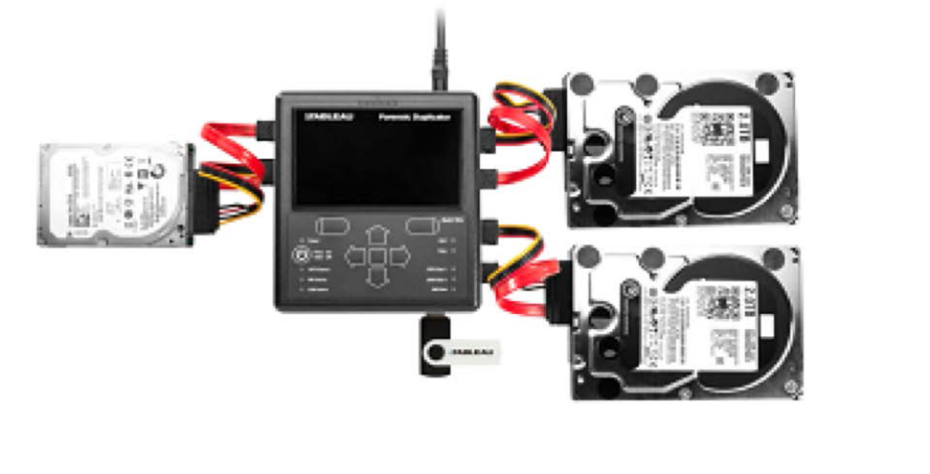
Tableau TD2u from Guidance Software
Notes:
Produced by Encase software company.
Can only read/copy on subject hard drive: no write operations allowed → (blocked!).

Slide 26
Contingency Planning for Image Acquisitions
Create a duplicate copy of your evidence image file
Make at least two images of digital evidence
  Use different tools or techniques
Copy host protected area of a disk drive as well
  Consider using a hardware acquisition tool that can access the drive at the BIOS level
Be prepared to deal with encrypted drives
  Whole disk encryption feature in Windows called BitLocker makes static acquisitions more difficult
  May require user to provide decryption key
Notes:
Contingency Planning for Image Acquisitions
Create a duplicate copy of your evidence image file
Make at least two images of digital evidence
Use different tools or techniques
Copy host protected area (HPA) of a disk drive as well (REQUIRES LOW-LEVEL IMAGING)
Consider using a hardware acquisition tool that can access the drive at the BIOS level
Be prepared to deal with encrypted drives
Whole disk encryption feature in Windows called BitLocker makes static acquisitions more difficult
May require user to provide decryption key
BitLocker 128-bit encryption is nearly unbreakable: slows down disk read and write, but very, very secure (unless Windows has a backdoor for their BitLocker Encryption program).

Slide 27
Acquiring Data with a Linux Boot CD
Linux can access a drive that isn’t mounted
Windows OSs and newer Linux automatically mount and access a drive
Forensic Linux Live CDs don’t access media automatically
  Which eliminates the need for a write-blocker
Using Linux Live CD Distributions
  Forensic Linux Live CDs
    Contain additionally utilities
Notes:
Acquiring Data with a Linux Boot CD
Linux can access a drive that isn’t mounted
Windows OSs and newer Linux automatically mount and access a drive
Forensic Linux Live CDs don’t access media automatically
Which eliminates the need for a write-blocker
Using Linux Live CD Distributions
Forensic Linux Live CDs
Contain additionally utilities
Sometimes, it is good to change boot order in the BIOS/UEFI so that you can boot from a drive other than the native OS hard drive of the system you are investigating.
This way, you can access the main hard drive without having to boot from a possibly compromised drive, and so that you can perform operations on the drive without having booted (launched OS) from it.

Slide 28
Acquiring Data with a Linux Boot CD
Acquiring data with dd in Linux
  dd (“data dump”) command
    Can read and write from media device and data file
    Creates raw format file that most computer forensics analysis tools can read
  Shortcomings of dd command
    Requires more advanced skills than average user
    Does not compress data
  dd command combined with the split command
    Segments output into separate volumes
Notes:
Acquiring Data with a Linux Boot CD
Acquiring data with dd in Linux
dd (“data dump”) command
Can read and write from media device and data file
Creates raw format file that most computer forensics analysis tools can read
Shortcomings of dd command
Requires more advanced skills than average user
Does not compress data
dd command combined with the split command
Segments output into separate volumes
Split command allows you to segment your image file into multiple files (volumes).

Slide 29
dd Syntax
A simple example:
  dd if=<what-to-copy> of=<where-to-put>
Default send to stdout
Can redirect via PIPE to netcat (nc) or cryptcat
dd if=/dev/fd0 | nc 192.168.1.2 2222
  Above, notice IP address and PORT number
  The nc IP PORT# function returns a stream to the dd function via the PIPE function (PIPE acts as a wrapper function)
Notes:
You can hash the original file and the copied file in order to see if they output the exact same 128-bit using md5 (32 hex digits) or sha1 for 160-bit or sha256 for 256-bit hash value output.
Hash function does not consider the file name (or any other meta-data; although there may be a way to include those values in a special hash function which may be useful), only contents in its calculation.
We can use 128-bit md5 hash for forensics (still acceptable), but we can no longer guarantee it is collision-free (practically speaking in some applications nowadays).
Use “sudo” in front of any Linux command= super/root user in Linux to execute with root privileges (user at the root, thus can make changes anywhere on the drive/system).

Slide 30
Options
bs=n (bytes)
  Input and output blocksize of n bytes
  bs=nk (n kilobytes)
  Larger block size (up to ~ 8k) can decrease imaging time
ibs=q obs=r
  Input block size q (bytes)
  Output block size r (bytes)
Count=s (blocks)
  Stop after you have transferred s INPUT blocks of data
Notes:
bs= block size (default copy size is 512 bytes)
Usually, larger block size = faster imaging time (because of how read/write on a hard disk drive with read/write head works; large blocks = larger sequential access = fastest kind of read and write from a hard disk drive – remember CIS-450 operating systems concepts).
Possible drawback of reading larger blocks to reduce disk-to-image time: if any blocks are corrupt, you risk losing more data; for example, default is 512 bytes, so if 1 block is corrupt, you would lose only 512 bytes; but if block size is 8Kb, then you would lose 8Kb if a block is lost or corrupt.

Slide 31
Options
Carving data w/dd
  skip=n (blocks)
    skip n BLOCKs ibs-sized blocks at start of input file before copying
  seek=n (blocks)
    Skip n BLOCKs obs-sized blocks in the output file before copying
Notes:
Skip is especially useful when you only want to copy files from a certain partition of a drive.

Slide 32
Separate each partitions
DOS Partition Table (4 partitions shown in this example)
Units are in 512-byte sectors
Slot Start End Length Description
00: ----- 0000000000 0000000000 0000000001 Primary Table (
01: ----- 0000000001 0000000031 0000000031 Unallocated
02: 00:00 0000000032 0001884159 0001884128 Linux (0x83)
03: 00:01 0001884160 0002097151 0000212992 Linux Swap
# dd if=sda.dd skip=32 count=1884128 of=sda1.dd
# dd if=sda.dd skip=1884160 count=212992 of=sda2.dd

Slide 33
What about errors?
If dd encounters an error while reading an input block, the copy process STOPS!
  Can force it to continue (using the conv=noerror flag)
  Include the sync along with the noerror flag to pad zeros in place of the errors encountered
    conv=noerror,sync
dd if=/dev/hdb1 of=/case1/hdb1.dd conv=noerror,sync
Notes:
Notice, if you are copying/creating image file and encounter an error, if you have a larger block size you specify for the process, then when an error is encountered more data will be skipped if you set that option (so, when you have a smaller block size, when errors are encountered and blocks are skipped, then less data will be lost as block errors are not chunked into larger error chunks).

Slide 34
Other uses for dd
Sterilize media
  if=/dev/zero of=TARGET
  overwrites target with zeros
  if=/dev/random of=TARGET
  overwrites target with random data
Notes:
Sterilize = overwrite with all zeroes = true wipe/deletion of data on a drive.
Alternatively, you can write in random data (perhaps only to parts of a disk in order to corrupt the drive or part of the drive); would take more time to do though since you would need a random algorithm for writing random data.

Slide 35
How do we access the source drive?
Physically remove the drive from the suspect computer and connect it to a forensic machine (a write block should be used)
  dd if=/dev/hda of=/dev/hdb OR
  dd if=/dev/hda of=/case1/evidence.dd
Imaging over a network/firewire connection using dd and nc

Slide 36
Use nc to acquire image over the crossover cable
Forensics machine listens on port 8888.
Once data is received,
  it is stored in a drive
    nc –l 8888 > /dev/hdb
  Or it is saved as an image file
    nc –l 8888 > evidence.dd
Suspect machine sends data dd
  if=/dev/hda | nc ipaddr 8888

Slide 37
Acquiring data with dcfldd in Linux
Acquiring data with dcfldd in Linux
  The dd command is intended as a data management tool
    Not designed for forensics acquisitions
  dcfldd is developed by the U.S. Department of Defense computer forensics lab
  It is an enhanced version of dd
Notes:
Acquiring Data with a Linux Boot CD
Acquiring data with dd in Linux (cont’d)
Follow the step starting on page 104 in the text to make an image of an NTFS disk on a FAT32 disk
Acquiring data with dcfldd in Linux
The dd command is intended as a data management tool
Not designed for forensics acquisitions

Slide 38
Acquiring data with dcfldd in Linux
dcfldd additional functions
  Specify hex patterns or text for clearing disk space
  Log errors to an output file for analysis and review
  Use several hashing options
  Refer to a status display indicating the progress of the acquisition in bytes (% complete shown)
  Split data acquisitions into segmented volumes with numeric extensions
  Verify acquired data with original disk or media data (runs hash code for verification)
Notes:
Acquiring Data with a Linux Boot CD
Acquiring data with dcfldd in Linux (cont’d)
dcfldd additional functions
Specify hex patterns or text for clearing disk space
Log errors to an output file for analysis and review (like errors reading blocks)
Use several hashing options
Refer to a status display indicating the progress of the acquisition in bytes
Split data acquisitions into segmented volumes with numeric extensions
Verify acquired data with original disk or media data

Slide 39
Validating Data Acquisitions
Validating evidence may be the most critical aspect of computer forensics
Requires using a hashing algorithm utility
Validation techniques
  CRC-32 (find random changes by accident); the rest are used to see if malicious changes to data occurred: MD5, and SHA-1 to SHA-256 or SHA-512
Notes:
Validating Data Acquisitions
Validating evidence may be the most critical aspect of computer forensics
Requires using a hashing algorithm utility
Validation techniques
CRC-32, MD5, and SHA-1 to SHA-512

Slide 40
Linux Validation Methods
Validating dd acquired data
  You can use md5sum or sha1sum utilities
  md5sum or sha1sum utilities should be run on all suspect disks and volumes or segmented volumes
Validating dcfldd acquired data
  Use the hash option to designate a hashing algorithm of md5, sha1, sha256, sha384, or sha512
  hashlog option outputs hash results to a text file that can be stored with the image files
  vf (verify file) option compares the image file to the original medium (using hash algorithm)
Notes:
Linux Validation Methods
Validating dd acquired data
You can use md5sum or sha1sum utilities
md5sum or sha1sum utilities should be run on all suspect disks and volumes or segmented volumes
Validating dcfldd acquired data
Use the hash option to designate a hashing algorithm of md5, sha1, sha256, sha384, or sha512
hashlog option outputs hash results to a text file that can be stored with the image files
vf (verify file) option compares the image file to the original medium

Slide 41
Using Remote Network Acquisition Tools
You can remotely connect to a suspect computer via a network connection and copy data from it
Remote acquisition tools vary in configurations and capabilities
Drawbacks
  Antivirus, antispyware, and firewall tools can be configured to ignore remote access programs
  Suspects could easily install their own security tools that trigger an alarm to notify them of remote access intrusions
Notes:
Using Remote Network Acquisition Tools
You can remotely connect to a suspect computer via a network connection and copy data from it
Remote acquisition tools vary in configurations and capabilities
Drawbacks
Antivirus, antispyware, and firewall tools can be configured to ignore remote access programs
Suspects could easily install their own security tools that trigger an alarm to notify them of remote access intrusions
Remote acquisition is more practical when the network that the computer is on you have full control and access to.

Slide 42
LAB 2 NOTES
If you cannot find a small enough USB drive, you can just do an image of part of the drive and compute hash for that part of drive you imaged.

